Slide 1

A+ Guide to Hardware, 9th Edition
Chapter 4
Supporting Processors and Upgrading Memory
Notes:
A+ Guide to Hardware, 9th Edition
Chapter 4
Supporting Processors and Upgrading Memory

Slide 2
Objectives
Compare characteristics and purposes of Intel and AMD processors used for personal computers
Install and upgrade a processor
Compare the different kinds of physical memory and how they work
Upgrade memory
Notes:
Objectives
Compare characteristics and purposes of Intel and AMD processors used for personal computers
Install and upgrade a processor
Compare the different kinds of physical memory and how they work
Upgrade memory

Slide 3
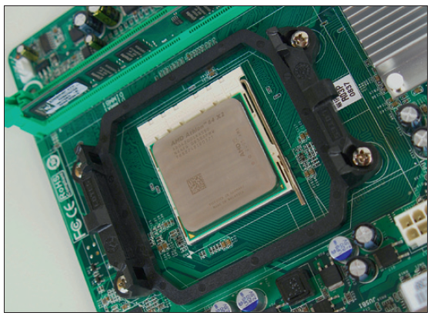
Types and Characteristics of Processors
Processor
Installed on motherboard
Determines system computing power
Two major processor manufacturers
Intel and AMD
Figure 4-1 An AMD Athlon 64 X2 installed in socket AM2+ with cooler not yet installed
Notes:
Types and Characteristics of Processors
Processor
Installed on motherboard
Determines system computing power
Two major processor manufacturers
Intel and AMD

Slide 4
Types and Characteristics of Processors
Features affecting processor performance and compatibility with motherboards
Processor speed
Socket and chipset the processor can use
Processor architecture
Multiprocessing abilities
Multiprocessing
Multithreading
Multicore processing
Dual processor
Notes:
Types and Characteristics of Processors
Features affecting processor performance and compatibility with motherboards
Processor speed
Socket and chipset the processor can use
Processor architecture
Multiprocessing abilities
Multiprocessing
Multithreading
Multicore processing
Dual processor

Slide 5
Types and Characteristics of Processors
Features affecting processor performance and compatibility with motherboards (cont’d)
Memory cache
Security
Memory features on the motherboard that the processor can support
Support for virtualization
Integrated graphics
Notes:
Types and Characteristics of Processors
Features affecting processor performance and compatibility with motherboards (cont’d)
Memory cache
Security
Memory features on the motherboard that the processor can support
Support for virtualization
Integrated graphics

Slide 6
How a Processor Works
Basic components
Input/output (I/O) unit
Manages data and instructions entering and leaving the processor
Control unit
Manages all activities inside the processor
One or more arithmetic logic units (ALUs)
Performs all logical comparisons, calculations
Notes:
How a Processor Works
Basic components
Input/output (I/O) unit
Manages data and instructions entering and leaving the processor
Control unit
Manages all activities inside the processor
One or more arithmetic logic units (ALUs)
Performs all logical comparisons, calculations

Slide 7
How a Processor Works
Basic components (cont’d)
Registers
Small holding areas on processor chip
Holds counters, data, instructions, and addresses that the ALU is currently processing
Internal memory caches (L1, L2, L3)
Holds data and instructions to be processed by ALU
Buses
Connect components within the processor housing
Notes:
How a Processor Works
Basic components (cont’d)
Registers
Small holding areas on processor chip
Holds counters, data, instructions, and addresses ALU is currently processing
Internal memory caches (L1, L2, L3)
Holds data and instructions to be processed by ALU
Buses
Connect components within the processor housing

Slide 8
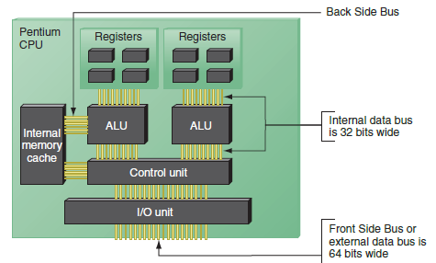
How a Processor Works
Figure 4-5 Since the Pentium processor was first released in 1993, the standard has been
for a processor to have two arithmetic logic units so that it can process
two instructions at once
Notes:
How a Processor Works

Slide 9
How a Processor Works
Processor frequency (speed)
Speed at which processor operates internally
Multiplier
Factor multiplied against system bus frequency
Determines processor frequency
System bus frequency × multiplier = processor frequency
Processors sold today contain ALUs and registers that can process 32 bits or 64 bits at a time
Notes:
How a Processor Works
Processor frequency (speed)
Speed at which processor operates internally
Multiplier
Factor multiplied against system bus frequency
Determines processor frequency
System bus frequency × multiplier = processor frequency
Processors sold today contain ALUs and registers that can process 32 bits or 64 bits at a time

Slide 10
How a Processor Works
Three categories of processors:
32-bit processors – known as x86 processors
Can handle 32-bit instructions from OS
Hybrid processors – known as x86-64 processors
Can handle a 32-bit OS or a 64-bit OS
AMD produced the first one (called AMD64)
64-bit processors – known as x64 processors or IA64
Require a 64-bit OS and can handle 32-bit applications only by simulating 32-bit processing
Notes:
How a Processor Works
Three categories of processors:
32-bit processors – known as x86 processors
Can handle 32-bit instructions from OS
Hybrid processors – known as x86-64 processors
Can handle a 32-bit OS or a 64-bit OS
AMD produced the first one (called AMD64)
64-bit processors – known as x64 processors or IA64
Require a 64-bit OS and can handle 32-bit applications only by simulating 32-bit processing

Slide 11
How a Processor Works
Memory cache (L1, L2, or L3)
Each core in a processor has its own L1 and L2 caches
All cores might share an L3 cache within the processor package
Improves performance
Memory controller
Included in processor package
Significant increase in system performance
Notes:
How a Processor Works
Memory cache (L1, L2, or L3)
Each core in a processor has its own L1 and L2 caches
All cores might share an L3 cache within the processor package
Improves performance
Memory controller
Included in processor package
Significant increase in system performance

Slide 12
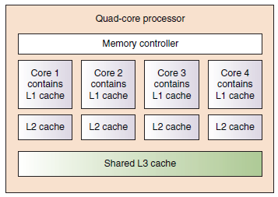
How a Processor Works
Figure 4-6 Quad-core processing with L1, L2, and L3 cache and the memory
controller within the processor housing
Notes:
How a Processor Works

Slide 13
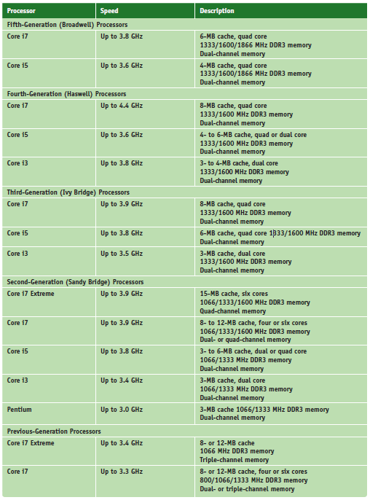
Intel Processors
Table 4-1 Current Intel processors (continues)
Notes:
Intel Processors

Slide 14
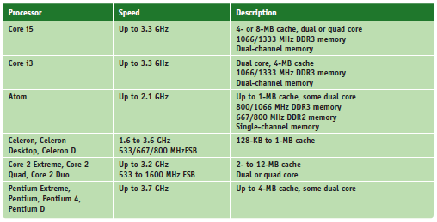
Intel Processors
Table 4-1 Current Intel processors (continued)
Notes:
Intel Processors

Slide 15
Intel Processors
Processor identification
Processor number
Example: two Core i7 processors are identified as:
i7-940 and i7-920
Centrino technology improves laptop performance
Processor, chipset, wireless network adapter are interconnected as a unit
Intel Atom processor
Low-powered processor
Used in low-cost desktops, laptops, and netbooks
Notes:
Intel Processors
Processor identification
Processor number
Example: two Core i7 processors are identified as:
i7-940 and i7-920
Centrino technology improves laptop performance
Processor, chipset, wireless network adapter are interconnected as a unit
Intel Atom processor
Low-powered processor
Used in low-cost desktops, laptops, and netbooks

Slide 16
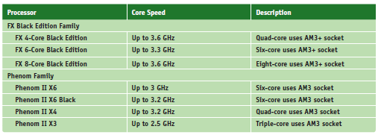
AMD Processors
Table 4-2 Current AMD processors (continues)
Notes:
AMD Processors

Slide 17
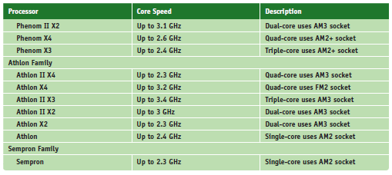
AMD Processors
Table 4-2 Current AMD processors (continued)
Notes:
AMD Processors

Slide 18
Selecting and Installing a Processor
PC repair technician tasks
Assemble a PC from parts
Exchange a faulty processor
Add a processor
Upgrade an existing processor
Must know how to:
Match processor to system
Install processor on motherboard
Notes:
Selecting and Installing a Processor
PC repair technician tasks
Assemble a PC from parts
Exchange a faulty processor
Add a processor
Upgrade an existing processor
Must know how to:
Match processor to system
Install processor on motherboard

Slide 19
Select a Processor to Match System Needs
First requirement
Select a processor that the motherboard is designed to support
Select the best processor meeting general system requirements and user needs
May have to sacrifice performance for cost
Notes:
Select a Processor to Match System Needs
First requirement
Select a processor that the motherboard is designed to support
Select the best processor meeting general system requirements and user needs
May have to sacrifice performance for cost

Slide 20
Install a Processor
Installing an Intel processor in Intel LGA socket (LGA 1150)
1. Read motherboard user guide and follow directions
2. Use an ESD strap or antistatic gloves
3. Remove the socket protective cover
4. Open the socket by pushing down on socket lever and gently push away from socket to lift lever
5. Remove protective cover from processor
6. Hold processor with index finger and thumb and align processor so the two notches on the edge of the processor line up with the posts embedded on the socket
Notes:
Install a Processor
Installing an Intel processor in socket LGA1150
1. Read motherboard user guide and follow directions
2. Use an ESD strap or antistatic gloves
3. Remove the socket protective cover
4. Open the socket by pushing down on socket lever and gently push away from socket to lift lever
5. Remove protective cover from processor
6. Hold processor with index finger and thumb and align processor so the two notches on the edge of the processor line up with the posts embedded on the socket

Slide 21
Install a Processor
Installing an Intel processor in Intel LGA socket (cont’d):
7. Ensure the processor is aligned correctly in socket
8. Return lever to its locked position
Notes:
Install a Processor
Installing an Intel processor in socket LGA1150 (cont’d):
7. Ensure the processor is aligned correctly in socket
8. Return lever to its locked position

Slide 22
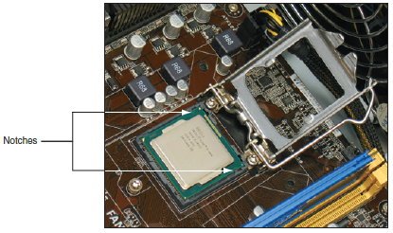
Install a Processor
Figure 4-14 Orient the processor so the notches line up with the posts on the socket
Notes:
Install a Processor

Slide 23
Install a Processor
General steps to install a cooler
1. Understand how cooler posts work
2. Apply thermal compound if necessary (may be preapplied)
3. Verify locking pins are turned counter-clockwise as far as they will go
4. Push down on each locking pin until it pops into the hole
5. Connect power cord from cooler fan to motherboard
Check BIOS/UEFI setup to verify the system recognized processor after system up and running
Notes:
Install a Processor
General steps to install a cooler
1. Understand how cooler posts work
2. Apply thermal compound if necessary (may be preapplied)
3. Verify locking pins are turned counter-clockwise as far as they will go
4. Push down on each locking pin until it pops into the hole
5. Connect power cord from cooler fan to motherboard
Check BIOS/UEFI setup to verify the system recognized processor after system up and running

Slide 24
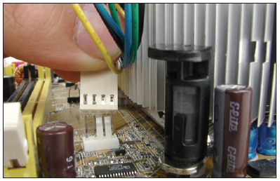
Install a Processor
Figure 4-17 Connect the cooler fan power cord to the motherboard CPU fan header
Notes:
Install a Processor

Slide 25
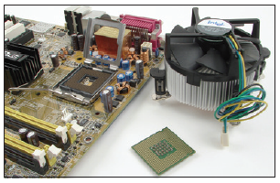
Install a Processor
Figure 4-26 A Pentium, cooler, and open socket 775
Notes:
Install a Processor

Slide 26
Install a Processor
Installing an AMD processor in an AMD socket (AM2+)
Summary of installation steps
1. Open the socket lever and remove protective cover
2. Place processor in the socket
3. Verify processor pins sitting slightly into the holes
4. Press the lever down and gently into position
5. Apply thermal compound and install cooler
6. Clip into place the clipping mechanism on one side of the cooler
7. Connect fan power cord to power connection
Verify system works
Notes:
Install a Processor
Installing an AMD processor in socket AM2+
Summary of installation steps
1. Open the socket lever and remove protective cover
2. Place processor in the socket
3. Verify processor pins sitting slightly into the holes
4. Press the lever down and gently into position
5. Apply thermal compound and install cooler
6. Clip into place the clipping mechanism on one side of the cooler
7. Connect fan power cord to power connection
Verify system works

Slide 27
Replacing the Processor in a Laptop
Before replacing, consider the laptop might still be under warranty or it might be more cost effective to replace the laptop rather than replacing processor
If decide to replace:
Use CPU supported by manufacturer and notebook model
For many laptops, remove the cover on the bottom to expose the processor fan and heat sink assembly
Some laptops may require you to remove the keyboard and keyboard bezel to reach the fan assembly and processor
Notes:
Replacing the Processor in a Laptop
Before replacing, consider the laptop might still be under warranty or it might be more cost effective to replace the laptop rather than replacing processor
If decide to replace:
Use CPU supported by manufacturer and notebook model
For many laptops, remove the cover on the bottom to expose the processor fan and heat sink assembly
Some laptops may require you to remove the keyboard and keyboard bezel to reach the fan assembly and processor

Slide 28
Replacing the Processor in a Laptop
If decide to replace (cont’d):
Lift the CPU from the socket
Lift straight up, without bending the CPU pins
Before placing the new processor into the socket
Be sure the socket screw is in the open position
Place the processor into its socket
Use thermal compound on top of the processor
Notes:
Replacing the Processor in a Laptop
If decide to replace (cont’d):
Lift the CPU from the socket
Lift straight up, without bending the CPU pins
Before placing the new processor into the socket
Be sure the socket screw is in the open position
Place the processor into its socket
Use thermal compound on top of the processor

Slide 29
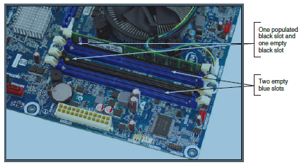
Memory Technologies
Random access memory (RAM)
Holds data and instructions used by CPU
Dynamic RAM (DRAM)
Memory modules used on a motherboard
Figure 4-36 RAM on motherboards today is stored in DIMMs
Notes:
Memory Technologies
Random access memory (RAM)
Holds data and instructions used by CPU
Dynamic RAM (DRAM)
Memory modules used on a motherboard

Slide 30
Memory Technologies
Variations of DRAM
DIMM – dual inline memory module
small outline DIMM (SO-DIMM) – used on laptops
microDIMMs – used on subnotebook computers
RIMM - rambus inline memory module
SIMM - single inline memory module
RIMM and SIMM (outdated)
Differences among variations of DRAM:
Data path width each module accommodates
How data moves from system bus to module
Notes:
Memory Technologies
Variations of DRAM
DIMM – dual inline memory module
small outline DIMM (SO-DIMM) – used on laptops
microDIMMs – used on subnotebook computers
RIMM and SIMM (outdated)
Differences among variations of DRAM:
Data path width each module accommodates
How data moves from system bus to module

Slide 31
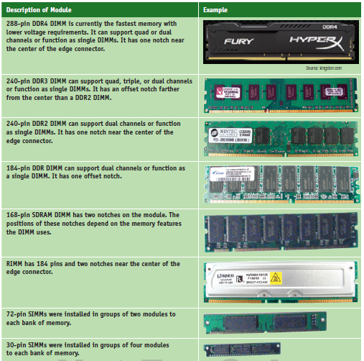
Memory Technologies
Table 4-3 Types of memory modules
Notes:
Memory Technologies

Slide 32
DIMM Technologies
DIMM (dual inline memory module)
64-bit data path
Independent pins on opposite sides of module
Older DIMMs
Asynchronous with system bus
Synchronous DRAM (SDRAM)
Runs synchronously with system bus
Two notches
Uses 168 pins
Notes:
DIMM Technologies
DIMM (dual inline memory module)
64-bit data path
Independent pins on opposite sides of module
Older DIMMs
Asynchronous with system bus
Synchronous DRAM (SDRAM)
Runs synchronously with system bus
Two notches
Uses 168 pins

Slide 33
DIMM Technologies
Double Data Rate SDRAM
Also called DDR SDRAM, SDRAM II, DDR
Two times faster than SDRAM and uses 184 pins
DDR2 SDRAM
Faster than DDR and uses less power
DDR3 SDRAM
Faster than DDR2 and uses less power
DDR2 and DDR3
Use 240 pins
Not compatible: use different notches
DDR4 – faster and uses less power than DDR3
Uses 288 pins
Notes:
DIMM Technologies
Double Data Rate SDRAM
Also called DDR SDRAM, SDRAM II, DDR
Two times faster than SDRAM and uses 184 pins
DDR2 SDRAM
Faster than DDR and uses less power
DDR3 SDRAM
Faster than DDR2 and uses less power
DDR2 and DDR3
Use 240 pins
Not compatible: use different notches
DDR4 – faster and uses less power than DDR3
Uses 288 pins

Slide 34
DIMM Technologies
Factors that affect capacity, features, and performance of DIMMS:
Number of channels they use
How much RAM is on one DIMM
Speed
Error-checking abilities
Buffering
Notes:
DIMM Technologies
Factors that affect capacity, features, and performance of DIMMS:
Number of channels they use
How much RAM is on one DIMM
Speed
Error-checking abilities
Buffering

Slide 35
DIMM Technologies
Early single channel DIMMs
Memory controller is accessed one DIMM at a time
Dual channels
Memory controller communicates with two DIMMs at the same time and doubles memory access speed
Triple channels
Accesses three DIMMs at once
DDR, DDR2, DDR3, and DDR4 DIMMs use dual channels
DDR3 DIMMs can also use triple channels
DDR3 and DDR4 can use quad channels
Notes:
DIMM Technologies
Early single channel DIMMs
Memory controller is accessed one DIMM at a time
Dual channels
Memory controller communicates with two DIMMs at the same time and doubles memory access speed
Triple channels
Accesses three DIMMs at once
DDR, DDR2, DDR3, and DDR4 DIMMs use dual channels
DDR3 DIMMs can also use triple channels
DDR3 and DDR4 can use quad channels

Slide 36
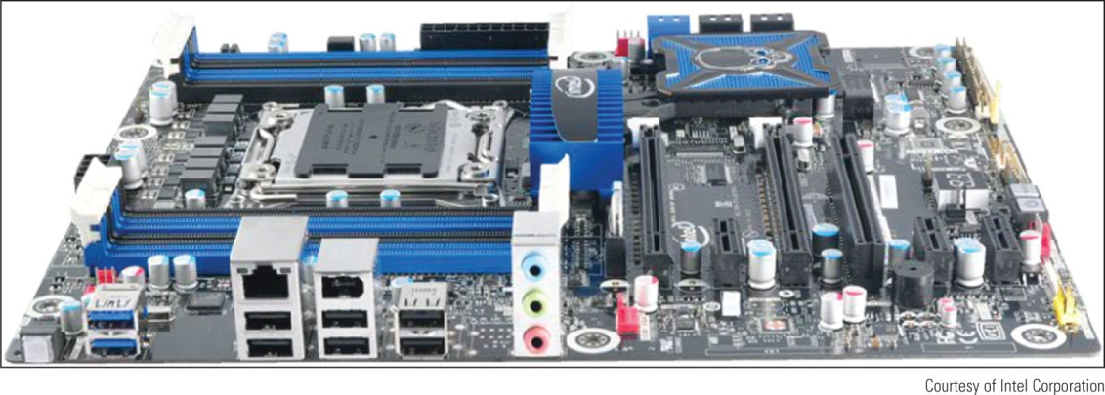
DIMM Technologies
Quad channeling
Introduced with Intel Sandy Bridge chipsets and processors
Processor can access four DIMMs at a time
Figure 4-41 The Intel Desktop Board DX79T0 has eight memory slots and supports two quad channels
Notes:
DIMM Technologies
Quad channeling
Introduced with Intel Sandy Bridge chipsets and processors
Processor can access four DIMMs at a time

Slide 37
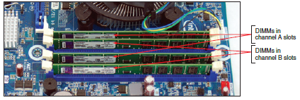
DIMM Technologies
Setting up dual channeling
Pair of DIMMs in a channel must be equally matched
Size, speed, features
Use same manufacturer (recommendation)
Figure 4-39 Matching pairs of DIMMs installed in four DIMM slots that support dual channeling
Notes:
DIMM Technologies
Setting up dual channeling
Pair of DIMMs in a channel must be equally matched
Size, speed, features
Use same manufacturer (recommendation)

Slide 38
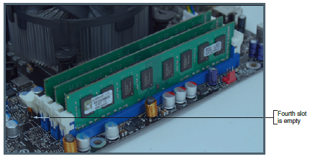
DIMM Technologies
Setting up triple-channeling
Three DIMM slots populated with three matching DDR3 DIMMs
Figure 4-40 Three identical DDR3 DIMMs installed in a triple-channel configuration
Notes:
DIMM Technologies
Setting up triple-channeling
Three DIMM slots populated with three matching DDR3 DIMMs

Slide 39
DIMM Technologies
DIMM Speed
Measured in MHz and PC rating
PC rating
Total bandwidth between module and CPU
DDR2 PC rating
Usually labeled PC2
DDR3 PC rating
Usually labeled PC3
DDR4 PC rating
Usually labeled PC4
Notes:
DIMM Technologies
DIMM Speed
Measured in MHz and PC rating
PC rating
Total bandwidth between module and CPU
DDR2 PC rating
Usually labeled PC2
DDR3 PC rating
Usually labeled PC3
DDR4 PC rating
Usually labeled PC4

Slide 40
DIMM Technologies
Single-sided DIMM
Memory chips installed on one side of module
Double-sided DIMM
Memory chips installed on both sides of module
Memory bank
Memory a processor addresses at one time
64 bits wide
Notes:
DIMM Technologies
Single-sided DIMM
Memory chips installed on one side of module
Double-sided DIMM
Memory chips installed on both sides of module
Memory bank
Memory a processor addresses at one time
64 bits wide
Dual ranked
DIMMs providing two or more banks
Reduces overall memory price at the expense of performance

Slide 41
DIMM Technologies
Error-correcting code (ECC)
Detects and corrects error in a single bit
Application: ECC makes 64-bit DIMM a 72-bit module
Parity – used by older SIMMs
Error-checking based on an extra (ninth) bit
Odd parity
Parity bit set to make odd number of ones
Even parity
Parity bit set to make even number of ones
Parity error
Number of bits conflicts with parity used
Notes:
DIMM Technologies
Error-correcting code (ECC)
Detects and corrects error in a single bit
Application: ECC makes 64-bit DIMM a 72-bit module
Parity – used by older SIMMs
Error-checking based on an extra (ninth) bit
Odd parity
Parity bit set to make odd number of ones
Even parity
Parity bit set to make even number of ones
Parity error
Number of bits conflicts with parity used

Slide 42
Types of Memory Used in Laptops
Today’s laptops use DDR, DDR3L, DDR3, or DDR2 SO-DIMM memory
Only use the type of memory the laptop is designed to support
The number of pins and the position of the notches on a SO-DIMM keep you from inserting the wrong module in a memory slot
Notes:
Types of Memory Used in Laptops
Today’s laptops use DDR, DDR3L, DDR3, or DDR2 SO-DIMM memory
Only use the type of memory the laptop is designed to support
The number of pins and the position of the notches on a SO-DIMM keep you from inserting the wrong module in a memory slot

Slide 43
How to Upgrade Memory
To upgrade memory means to add more RAM to a computer
Adding more RAM might solve:
Slow performance
Applications refusing to load
An unstable system
Windows “Insufficient memory” error message
Notes:
How to Upgrade Memory
To upgrade memory means to add more RAM to a computer
Adding more RAM might solve:
Slow performance
Applications refusing to load
An unstable system
Windows “Insufficient memory” error message

Slide 44
How to Upgrade Memory
Questions to ask
How much RAM do I need and how much is currently installed?
How many and what kind of memory modules are currently installed on my motherboard?
How many and what kind of modules can I fit on my motherboard?
How do I select and purchase the right modules for my upgrade?
How do I physically install the new modules?
Notes:
How to Upgrade Memory
Questions to ask
How much RAM do I need and how much is currently installed?
How many and what kind of memory modules are currently installed on my motherboard?
How many and what kind of modules can I fit on my motherboard?
How do I select and purchase the right modules for my upgrade?
How do I physically install the new modules?

Slide 45
How Much Memory Do I Need and How Much Is Currently Installed?
Best answer: “All you can get”
Windows 10 require at least 4 GB RAM
But more is better
32-bit installation of Windows 10
4 GB installed RAM
64-bit installation of Windows 10
More than 4 GB installed RAM
Notes:
How Much Memory Do I Need and How Much Is Currently Installed?
Best answer: “All you can get”
Windows 8/7 require at least 2 GB RAM
But more is better
RAM limit for a 32-bit OS
4 GB installed RAM
64-bit installation of Windows 8
Can use up to 128 GB of RAM
64-bit installation of Windows 7 Home Premium
Can use up to 16 GB of RAM

Slide 46
How Many and What Kind of Modules Are Currently Installed?
Open the case and look at memory slots
How many slots?
How many filled?
Review module imprint
Examine module for physical size and notch position
Read motherboard documentation
See if board supports dual, triple, or quad channels
Last resort
Take motherboard and old memory modules to a good computer parts store for confirmation
Notes:
How Many and What Kind of Modules Are Currently Installed?
Open the case and look at memory slots
How many slots?
How many filled?
Review module imprint
Examine module for physical size and notch position
Read motherboard documentation
See if board supports dual, triple, or quad channels
Last resort
Take motherboard and old memory modules to a good computer parts store for confirmation

Slide 47
How Many and What Kind of Modules Can Fit on My Motherboard?
Read motherboard documentation
Indicates how much memory motherboard can physically hold
DIMM modules
DIMMs can be installed as single modules
Motherboard supporting dual channeling
Install matching DIMMs in each channel for best performance
DDR3 board supporting triple channeling
For best performance install three matching DIMMs in triple-channel slots
Notes:
How Many and What Kind of Modules Can Fit on My Motherboard?
Read motherboard documentation
Indicates how much memory motherboard can physically hold
DIMM modules
DIMMs can be installed as single modules
Motherboard supporting dual channeling
Install matching DIMMs in each channel for best performance
DDR3 board supporting triple channeling
For best performance install three matching DIMMs in triple-channel slots

Slide 48
How Many and What Kind of Modules Can Fit on My Motherboard?
Motherboard using DDR DIMMs with dual channeling
Allows three different DDR DIMM speeds in one to four sockets, supports dual channeling
Two blue memory slots and two black slots
For dual channeling
Matching DIMMs must be installed in the two blue sockets
If two DIMMs installed in the two black sockets
They must match each other
Notes:
How Many and What Kind of Modules Can Fit on My Motherboard?
Motherboard using DDR DIMMs with dual channeling
Allows three different DDR DIMM speeds in one to four sockets, supports dual channeling
Two blue memory slots and two black slots
For dual channeling
Matching DIMMs must be installed in the two blue sockets
If two DIMMs installed in the two black sockets
They must match each other

Slide 49
How Do I Select and Purchase the Right Memory Modules?
Compromises if the exact match is not available:
Mixing unbuffered memory with buffered or registered memory will not work
Match memory module manufacturer, if possible
In a pinch, try using memory from two different manufacturers
If mixing memory speeds:
All modules perform at slowest speed
Notes:
How Do I Select and Purchase the Right Memory Modules?
Compromises if the exact match is not available:
Mixing unbuffered memory with buffered or registered memory will not work
Match memory module manufacturer, if possible
In a pinch, try using memory from two different manufacturers
If mixing memory speeds:
All modules perform at slowest speed

Slide 50
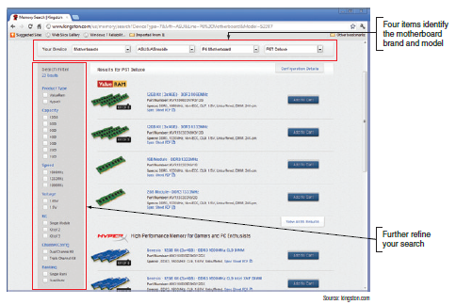
How Do I Select and Purchase the Right Memory Modules?
Using a web site to research your purchase
Look for search utility matching modules to board
Figure 4-52 The Kingston web site DIMM recommendations for a particular motherboard
Notes:
How Do I Select and Purchase the Right Memory Modules?
Using a web site to research your purchase
Look for search utility matching modules to board

Slide 51
How Do I Install the New Modules?
Precautions:
Always use an ESD strap
Turn off power, unplug power cord, press power button, remove case cover
Handle memory modules with care
Do not touch edge connectors on memory module or memory slot
Do not stack cards or modules
Look for notches on one side or in the middle for correct orientation
Notes:
How Do I Install the New Modules?
Precautions:
Always use an ESD strap
Turn off power, unplug power cord, press power button, remove case cover
Handle memory modules with care
Do not touch edge connectors on memory module or memory slot
Do not stack cards or modules
Look for notches on one side or in the middle for correct orientation

Slide 52
How Do I Install the New Modules?
Installing DIMMS
Pull out supporting arms on the sides of the slot
Use notches on DIMM edge connector as a guide
Insert DIMM straight down into the slot
Ensure supporting arms lock into position
New installations are generally uncomplicated
Usually involve placing memory on motherboard
Older computers may need change to BIOS setup
If new memory not recognized try reseating the module
Notes:
How Do I Install the New Modules?
Installing DIMMS
Pull out supporting arms on the sides of the slot
Use notches on DIMM edge connector as a guide
Insert DIMM straight down into the slot
Ensure supporting arms lock into position
New installations are generally uncomplicated
Usually involve placing memory on motherboard
Older computers may need change to BIOS setup
If new memory not recognized try reseating the module

Slide 53
How to Upgrade Memory on a Laptop
Upgrade process is similar to desktops
Considerations:
Make sure warranty not being voided
Search for best buy on a suitable and authorized part
General steps:
Decide how much memory to upgrade
Purchase memory
Install it
Be sure to match the type of memory to the type the laptop supports
Notes:
How to Upgrade Memory on a Laptop
Upgrade process is similar to desktops
Considerations:
Make sure warranty not being voided
Search for best buy on a suitable and authorized part
General steps:
Decide how much memory to upgrade
Purchase memory
Install it
Be sure to match the type of memory to the type the laptop supports

Slide 54
Summary
Processor: most important motherboard component
Two major manufacturers are Intel and AMD
Processors are rated by speed of the system bus, the socket and chipset, processor architecture, multi-core rating, internal memory cache, amount and type of RAM and computing technologies
Memory cache inside the processor housing can be L1, L2, and L3 cache
Core of processor has two arithmetic logic units (ALUs) and each core can process two threads at once
Notes:
Summary
Processor: most important motherboard component
Two major manufacturers are Intel and AMD
Processors are rated by speed of the system bus, the socket and chipset, processor architecture, multi-core rating, internal memory cache, amount and type of RAM and computing technologies
Memory cache inside the processor housing can be L1, L2, and L3 cache
Core of processor has two arithmetic logic units (ALUs) and each core can process two threads at once

Slide 55
Summary
Current families of Intel processors include Core, Atom, Celeron, and Pentium
Current AMD processor families include FX, Phenom, Athlon, and Sempron
Select a processor that the motherboard supports
When installing, always follow directions in motherboard user guide
DRAM is stored on DIMMs for desktops and SO-DIMMs for laptops
DIMMs can be single-sided or double-sided
Notes:
Summary
Current families of Intel processors include Core, Atom, Celeron, and Pentium
Current AMD processor families include FX, Phenom, Athlon, and Sempron
Select a processor that the motherboard supports
When installing, always follow directions in motherboard user guide
DRAM is stored on DIMMs for desktops and SO-DIMMs for laptops
DIMMs can be single-sided or double-sided

Slide 56
Summary
DIMMs can work together in dual, triple, or quad channels
DIMM speeds are measured in MHz or PC rating
The memory controller can check memory for errors and possibly correct those errors using ECC
Buffers and registers are used to hold data and amplify a data signal
CAS Latency and RAS Latency measure access time to memory
When upgrading memory, use the type, size, and speed the motherboard supports
Notes:
Summary
DIMMs can work together in dual, triple, or quad channels
DIMM speeds are measured in MHz or PC rating
The memory controller can check memory for errors and possibly correct those errors using ECC
Buffers and registers are used to hold data and amplify a data signal
CAS Latency and RAS Latency measure access time to memory
When upgrading memory, use the type, size, and speed the motherboard supports

